Slide 1
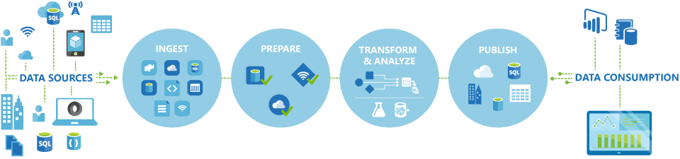
Course Overview
Azure Data Factory
A managed cloud service for building & operating data pipelines

Slide 2
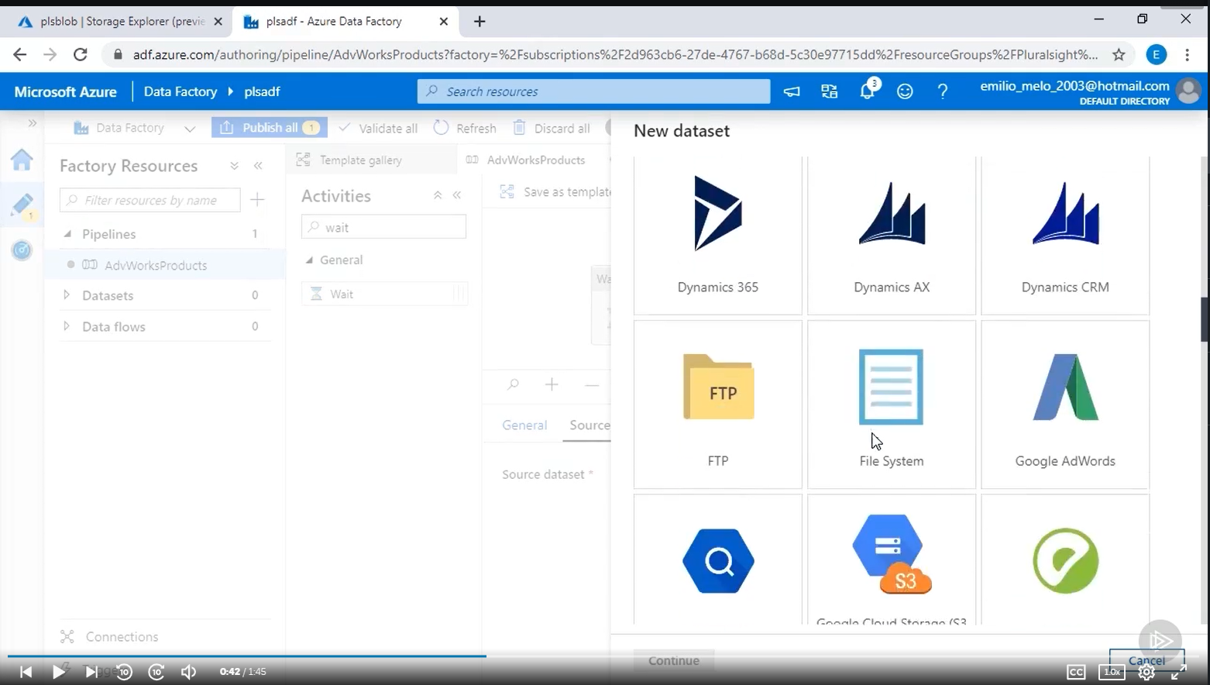
Course Overview

Slide 3
What we will learn?
How do we ingest data?
How do we prepare and transform data?
How do we publish data?
structured data
Data quality
Data Warehouse
semi-structured data
Data transformations
Slowly Changing Dimensions

Slide 4
What you will achieve at the end of this course
You will have a sound understanding of Data Factory and be able to implement pipelines using Data Factory

Slide 5
Course Overview
Prerequisites
Knowledge of databases
Motivation & Interest ☺

Slide 6









Appendix

